Slide 1
ELEC4544 Final Report Depth estimation application on SLAM robot
TAM YUNG YIP， Wenshuo ZHANG

Slide 2
Today’s Agent:
Background for the whole project
SLAM Robot with Pretrained Depth Estimation Model in Application
Some former work before the final decision

Slide 3
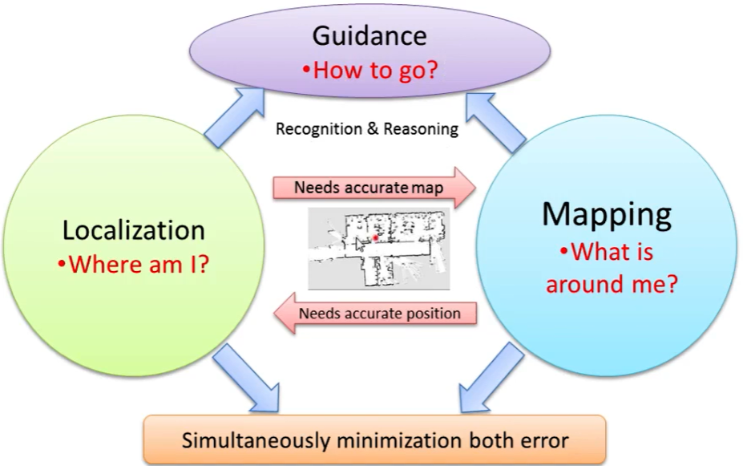
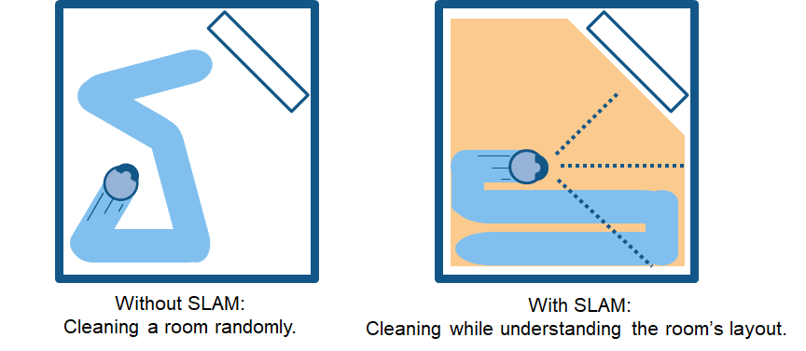
Background of SLAM
Difficulty in robotic :
1.Robot don’t know the own position without a map
2.Robot can’t do mapping without knowing its own position
SLAM (Simultaneous Localization and Mapping) technology is developed to solve these problem in the same times (path planning)

Slide 4
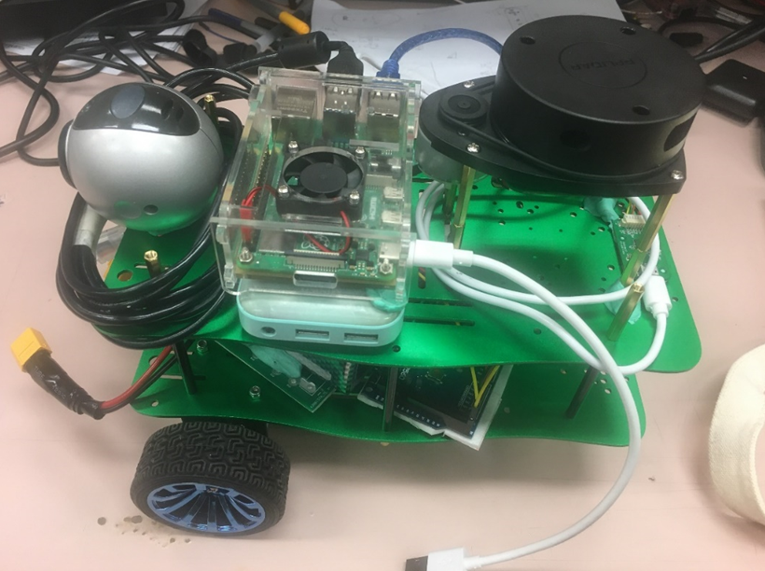
Hardware design
Motor (with encoder count)
Motor driver (capable for driving motor)
Lidar (for mapping and localize its own position)
Battery (enough current provided)
Microcontroller (control car base)
Computer (remote the robot)

Slide 5
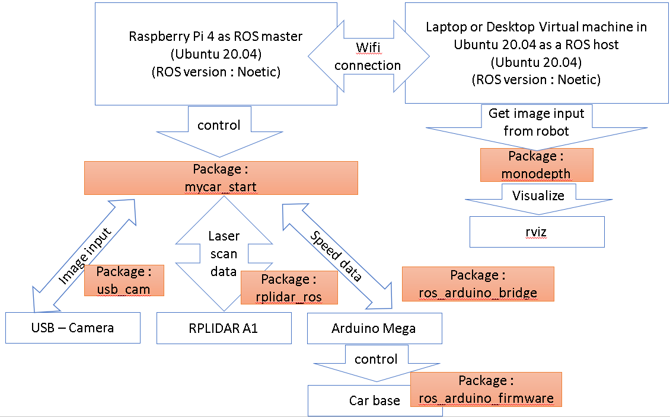
ROS(Robot Operating System) STRUCTURE
Different nodes communication
Different computer communication

Slide 6
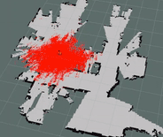
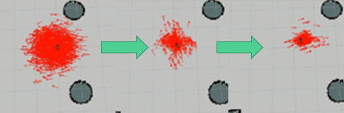
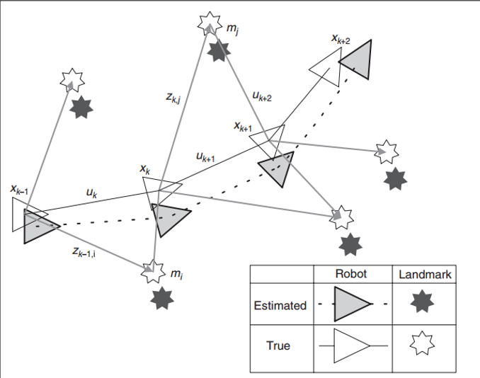
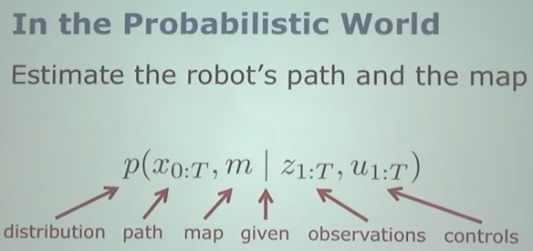
SLAM technology
Main idea : repeat iterations of probabilistic algorithms
1. Lidar to get map data
2. Encoder to locate robot position
3. Coordinate transform of the data obtained to draw a map and update robot position
4. Use algorithm to minimize the errors
(AMCL) use particle filter method to
update the probability of robot position

Slide 7
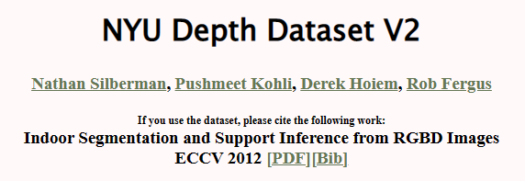

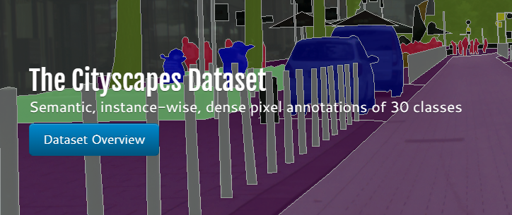
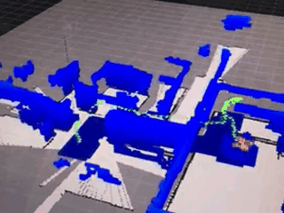
What’s our initial idea
What do we need?
City outside
Training data
Outside
Home but not good quality
Same size of input and output
Model
Easy to train
Final target
SLAM: Fast and correct

Slide 8
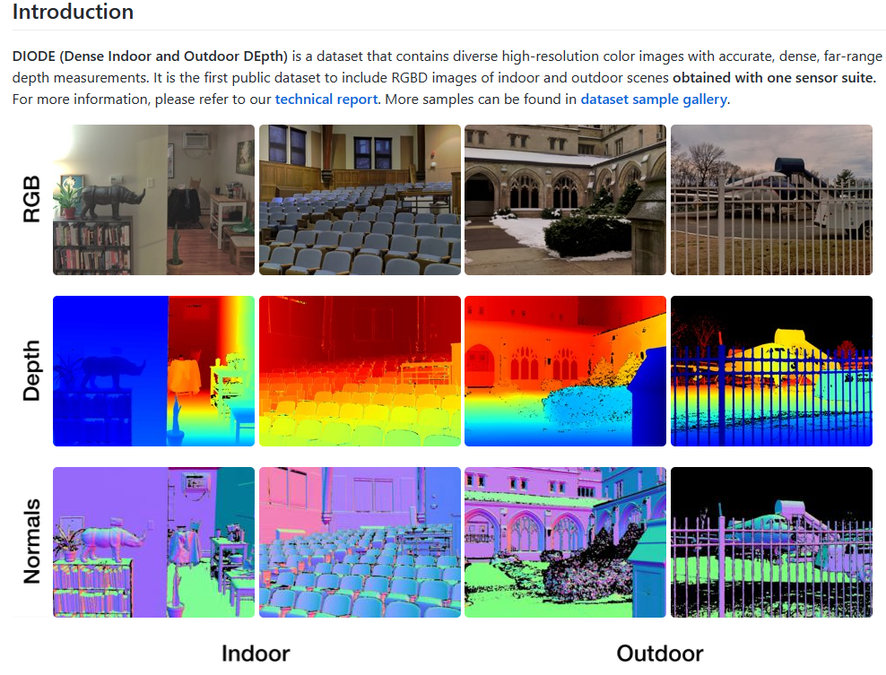
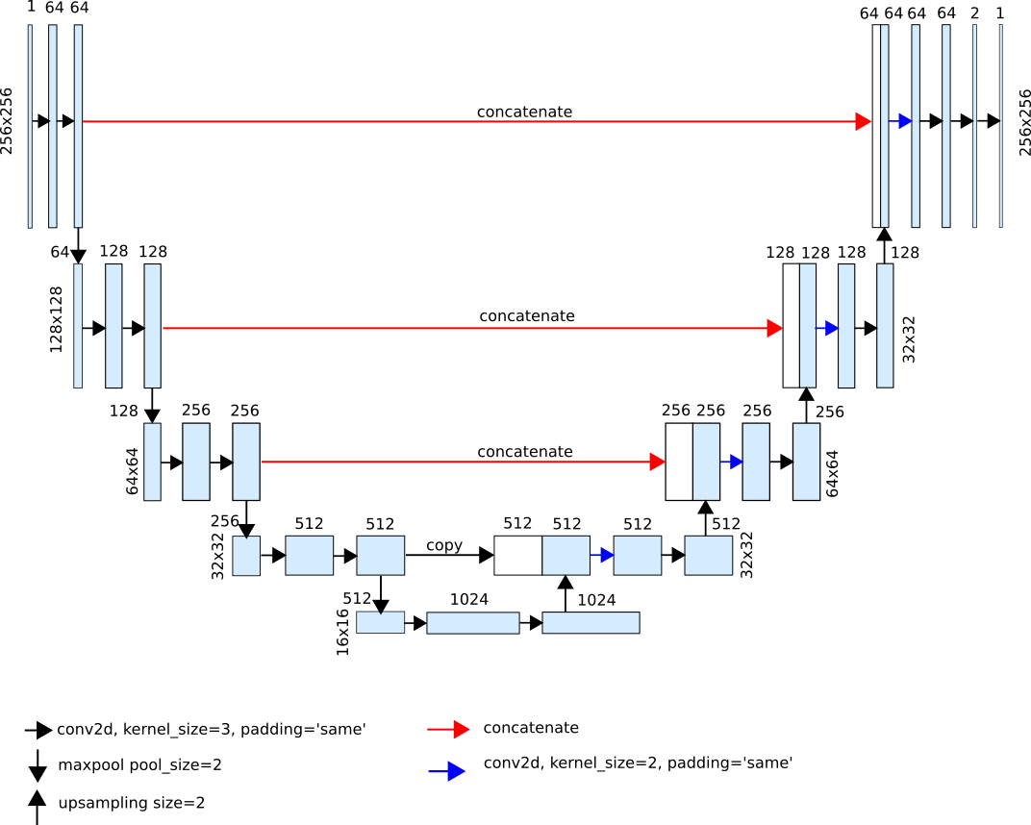
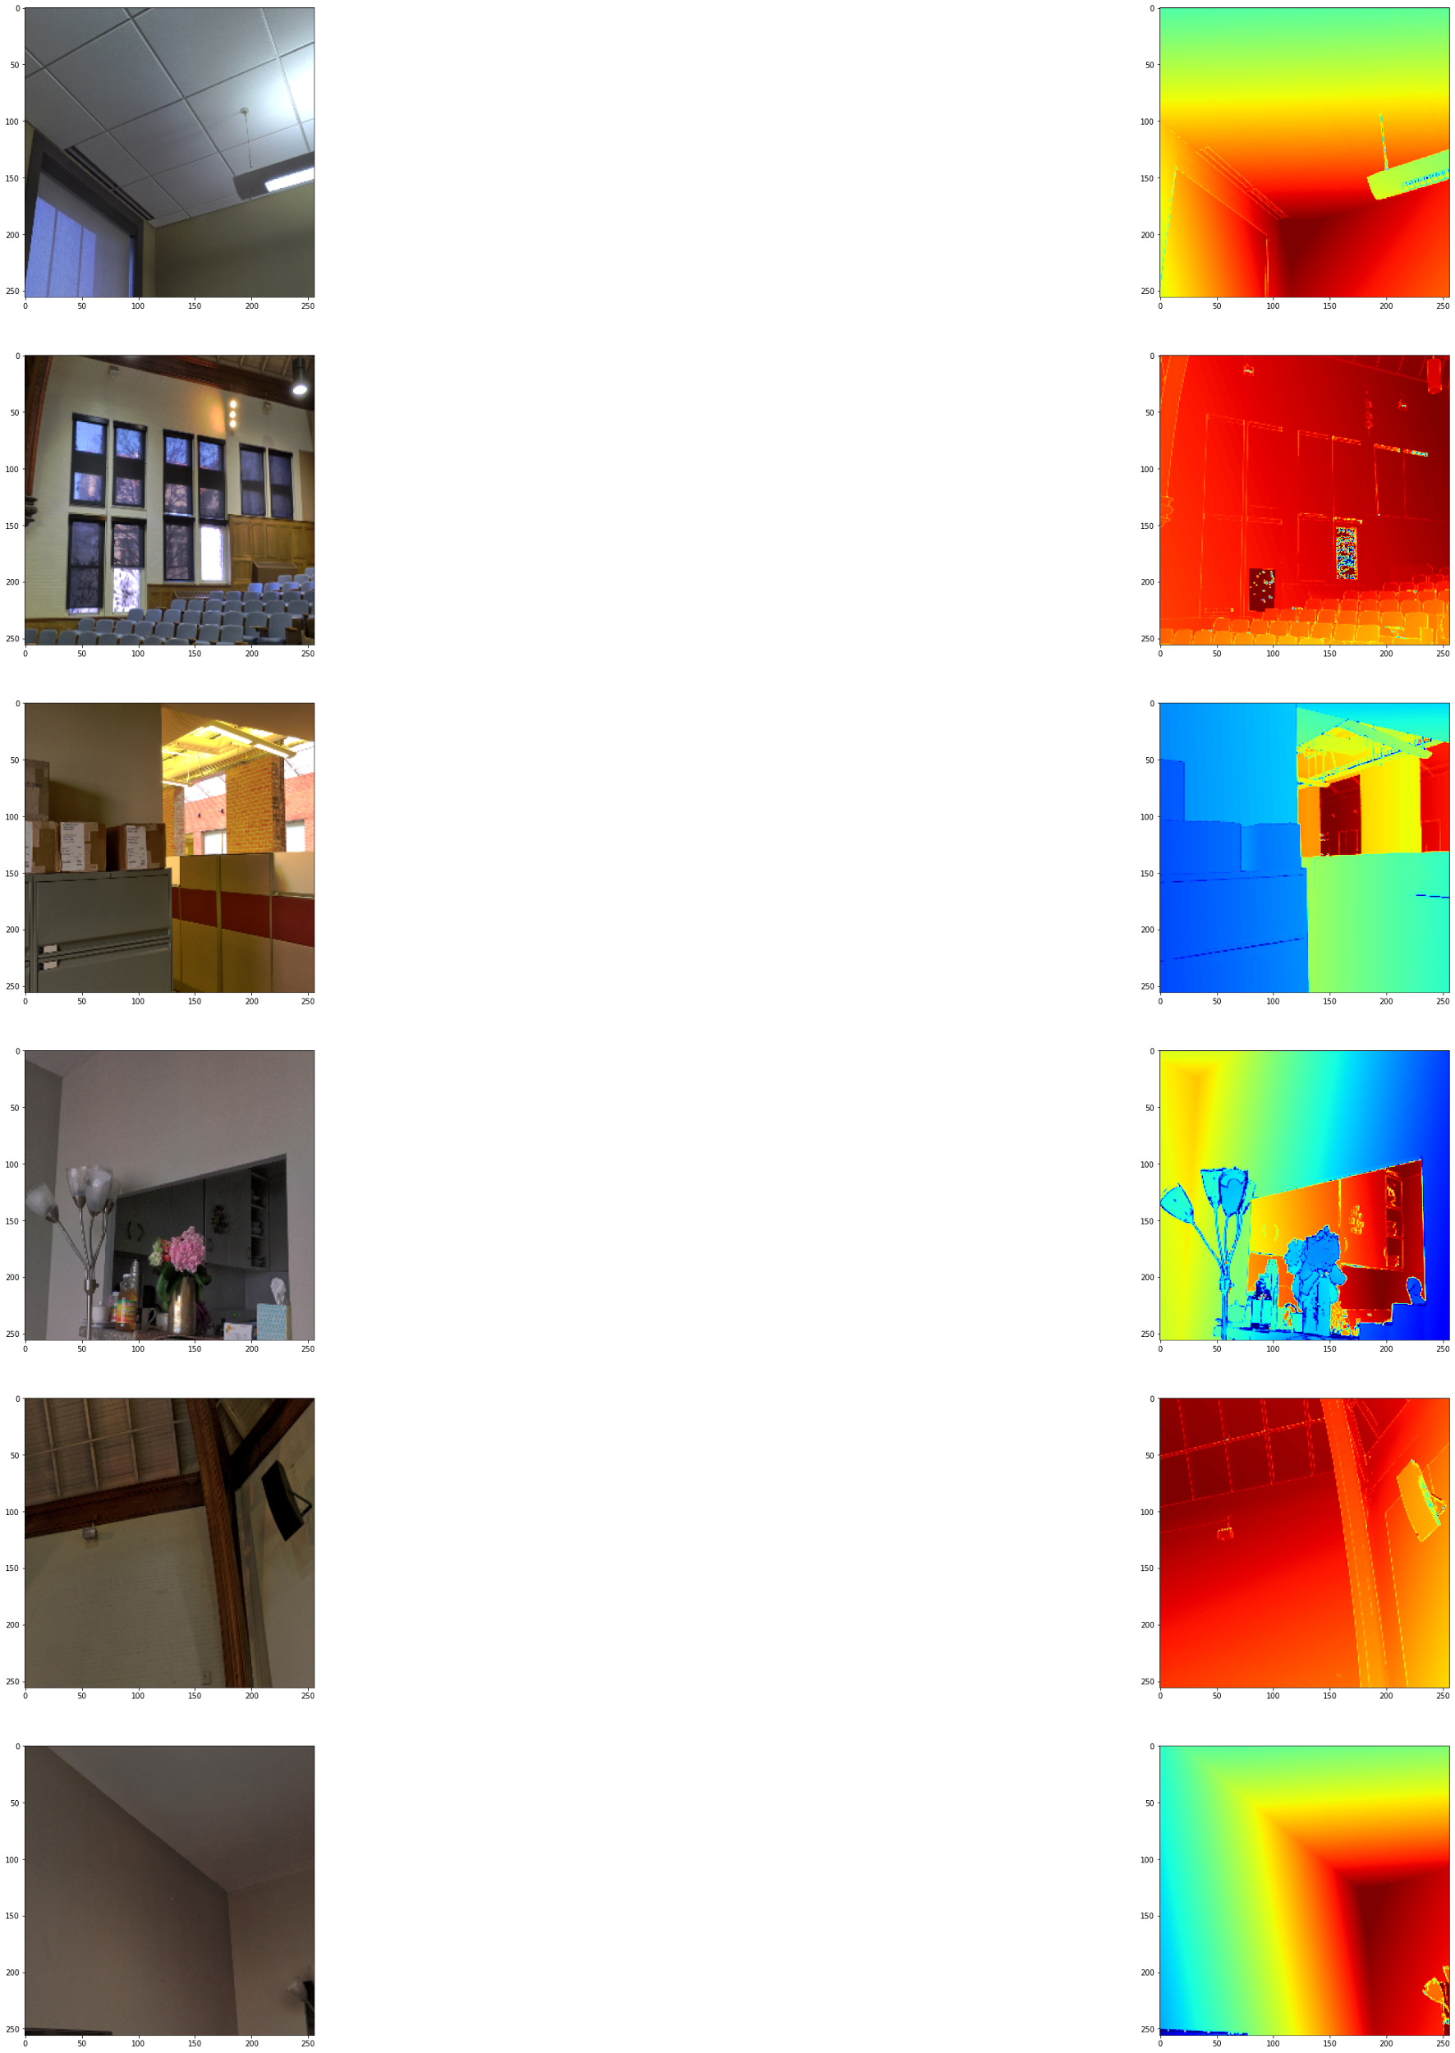
Have a try:
Result of the easy U-net

Slide 9
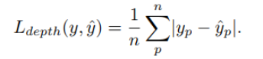
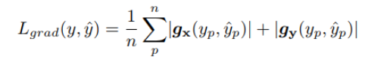
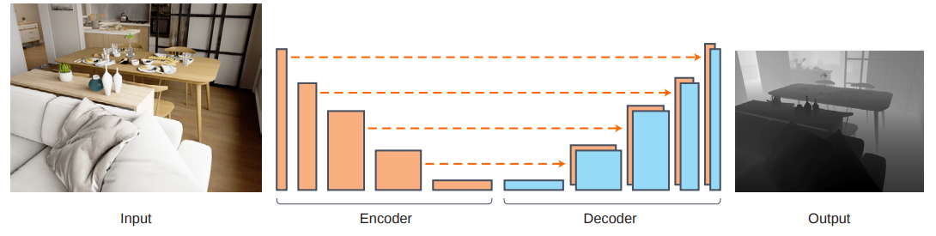
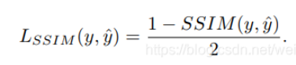
That is too easy to capture all details
Embed pretrained Model
Encode
Change into pretrained Densenet-169
U-net decoder is good(Real reason is there is no pretrained model for this)
Another problem is that the quality of output is not good enough
We use up sampling together

Slide 10
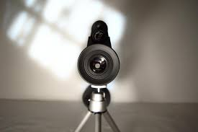
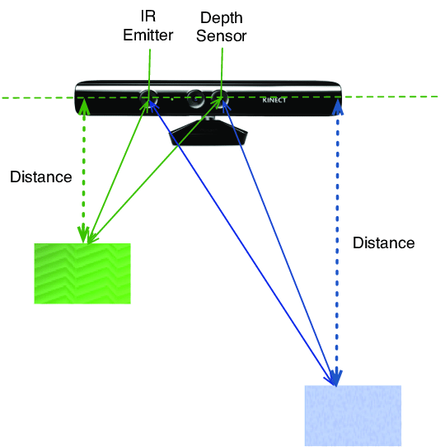
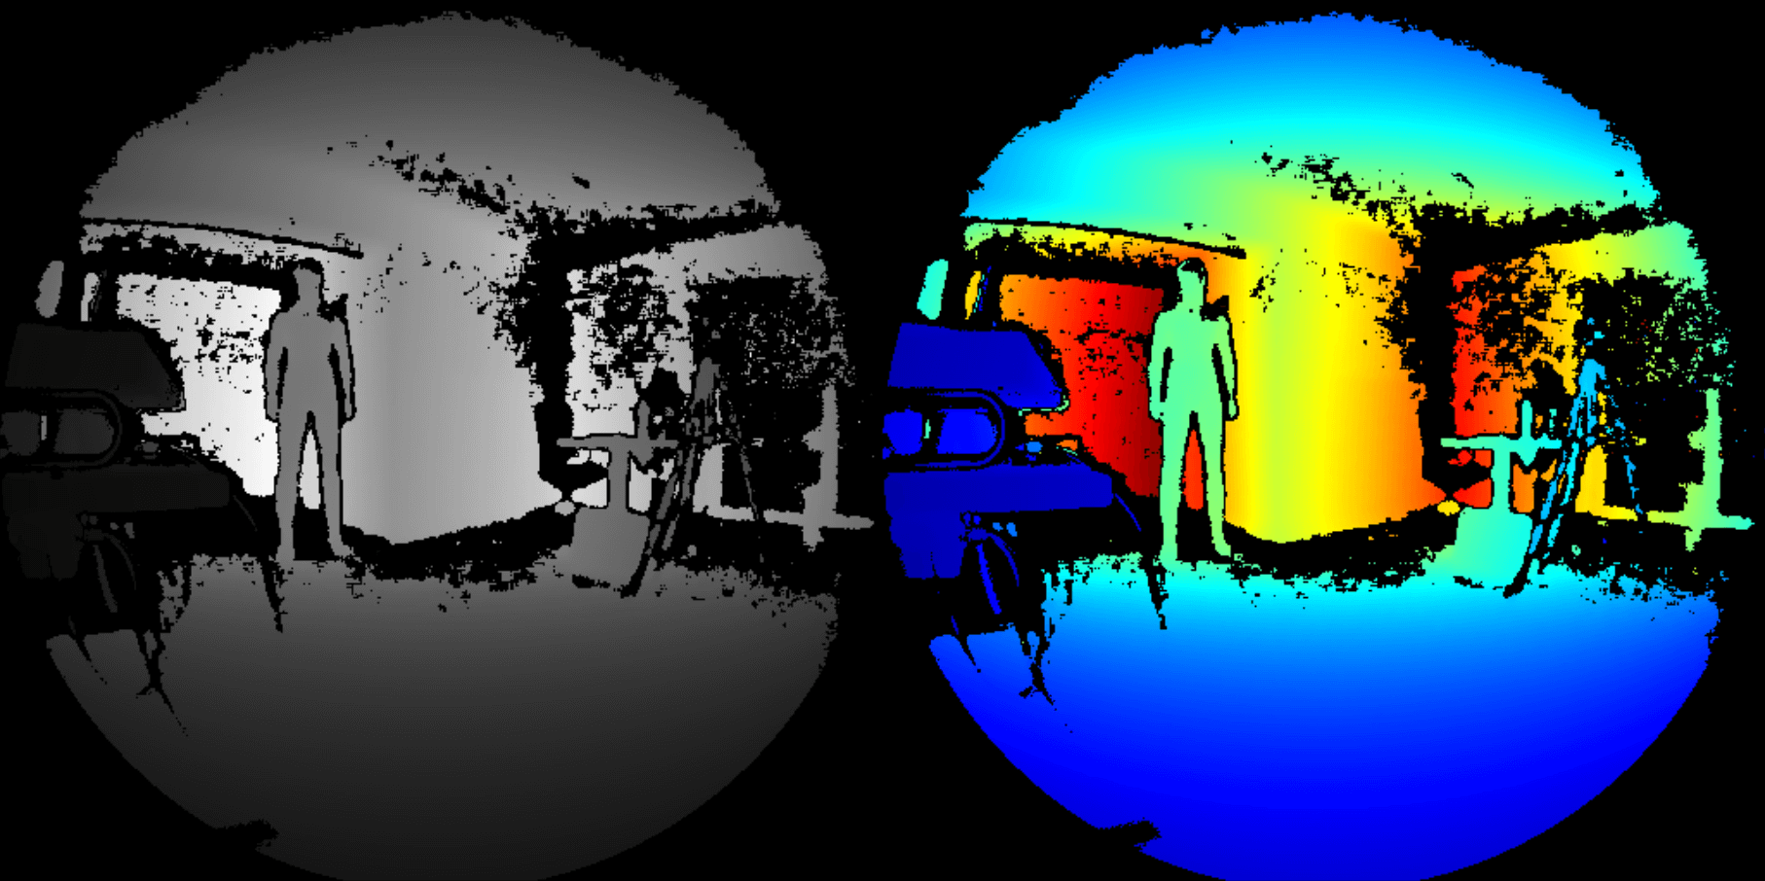
Depth camera: Depth estimation
Common SLAM robot method: depth camera
- Pros: easy to have 3D image
- Cons: too expensive

Slide 11
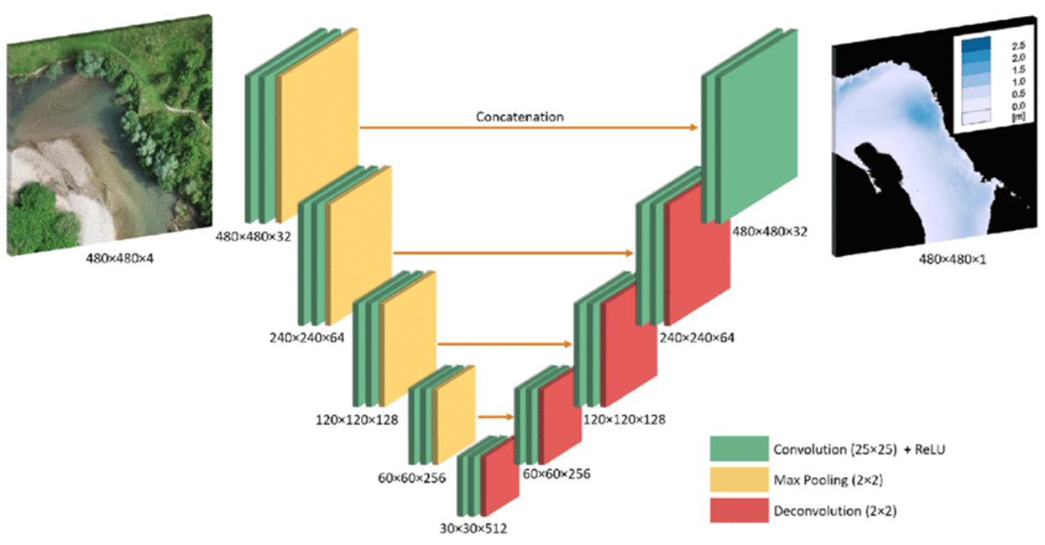
Monocular depth estimation
Computer vision : deep learning model
U-net structure of CNN
Up-sampling and down-sampling for feature extraction

Slide 12
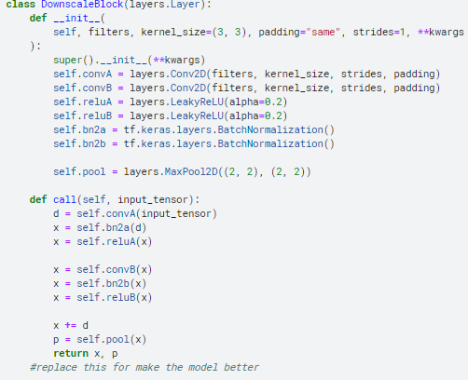
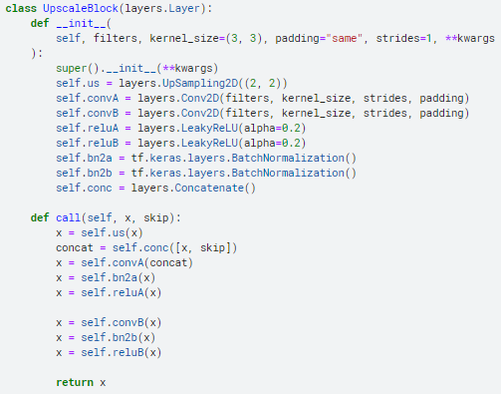
Monocular depth estimation
Computer vision : deep learning model
U-net structure of CNN
Up-sampling and down-sampling for feature extraction

Slide 13
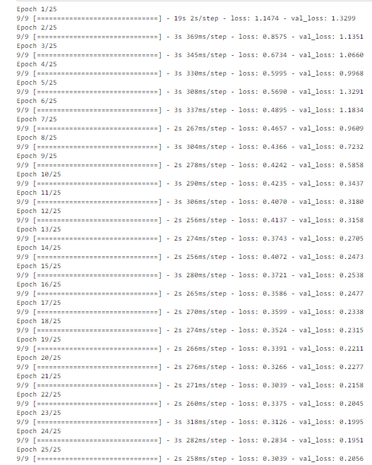
Depth estimation result

Slide 14
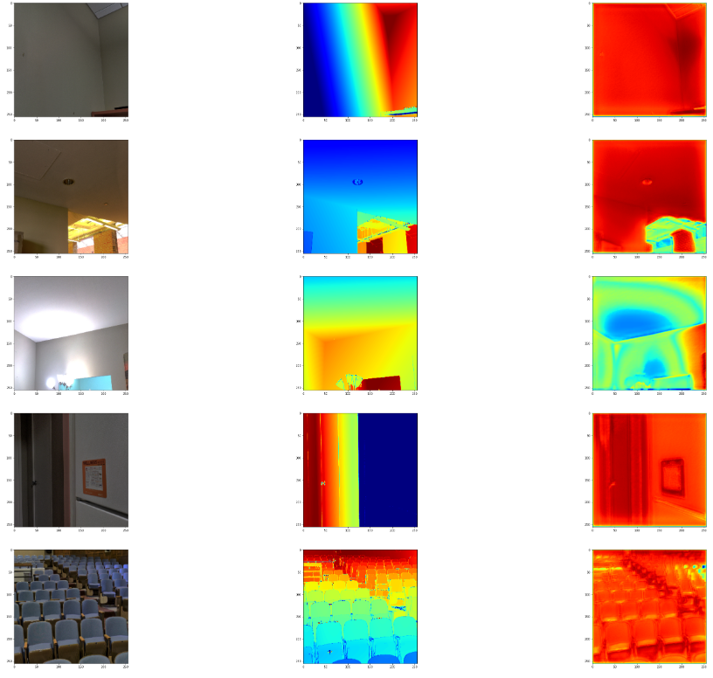

Slide 15
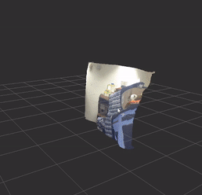
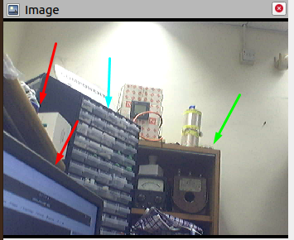
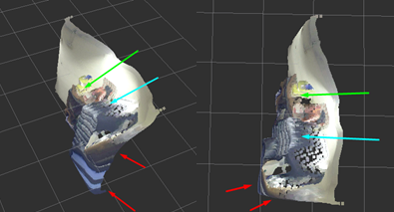
Depth estimation result
Able to response on the monocular camera in ROS structure
Output as 3D point cloud for visualization
Arrows >> red: nearest , blue: middle , green : farthest

Slide 16
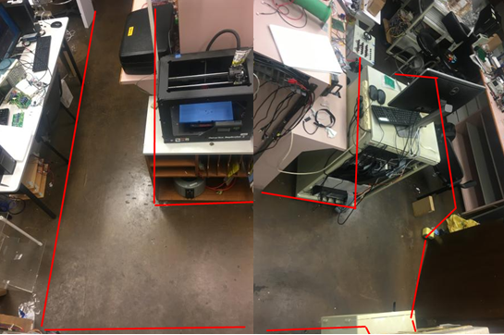
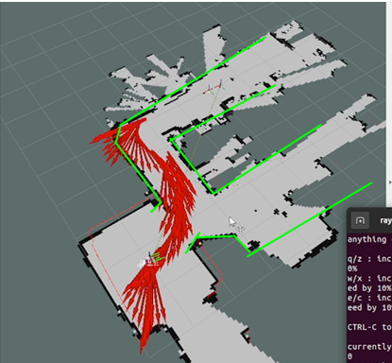
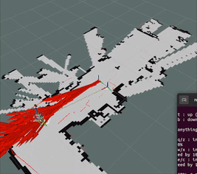
RESULT :SLAM (remote)
Environment : HW301
1. Able to do SLAM with remote control from keyboard
2. Expected mapping result

Slide 17
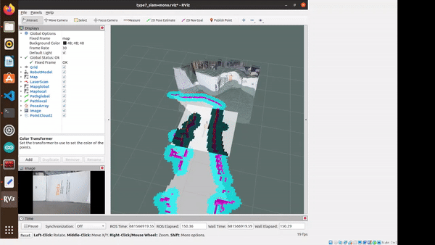
RESULT :apply on SLAM robot

